Slide 1
Survey on Cross-domain Recommendation

Slide 2
Outline
Motivation: TV Recommendation
Recommendation Systems
Content-based personalized recommendation
Collaborative-ﬁltering approach (CF)
Hybrid approach: incorporating content with CF
Knowledge-based approach
Cross-Domain Recommendation
A semantic-based framework (The HetRec’11 paper)
Our Ideas on the TV Project
For Your Comments and Suggestions

Slide 3
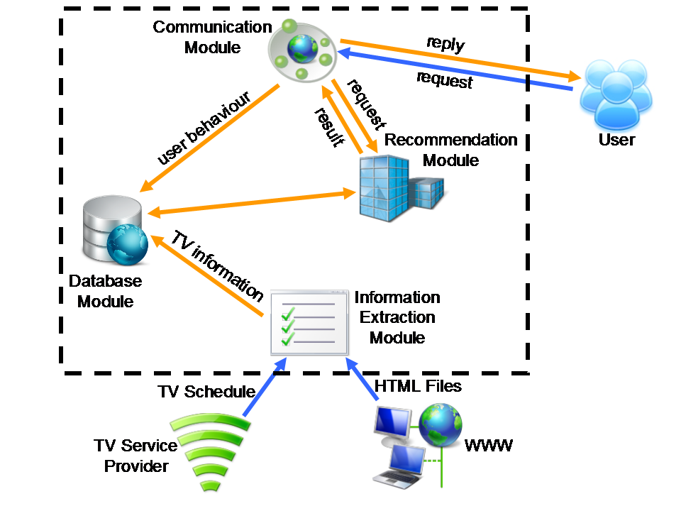
Motivation: TV Recommendation
Our system structure

Slide 4
Motivation: TV Recommendation
Original Map:
Programs viewing history -> Programs
New Map:
Programs viewing history -> Advertisements
Programs information and advertisements information
are in different domains.

Slide 5
Recommendation Systems
Content-based personalized recommendation
Collaborative-ﬁltering approach (CF)
Hybrid approach: incorporating content with CF
Knowledge-based approach

Slide 6
Content-based recommendation
Content-based approaches recommend items based on the contents of items a user has experienced before.
Rely on the traditional information retrieval techniques.
Compute similarities between the new item and items liked by a user.

Slide 7
Collaborative-filtering (CF)
Make recommendations by observing like-minded groups.
Two kinds of CF:
User-based CF
Item-based CF
Cold-start problem
Rating sparsity problem

Slide 8
Hybrid approach
By combining content-based and CF approach, we can smooth out their drawbacks and obtain both individual as well as collective experiences about the items being recommended.
Content-based approach provides ratings to CF
CF enriches the diversity of content-based recommendations

Slide 9
Knowledge-based approach
Knowledge-based approach builds the user proﬁle gradually by many forms of knowledge structure.
Similar to content-based approach, goes even deeper into the information
User interaction
Using ontology

Slide 10
Cross-Domain Recommendation
Information are from two different domains
limits the content-based approach
Cold-start problem and rating sparsity problem are main concerns using CF approach
A Generic Semantic-based Framework for Cross-domain Recommendation (HetRec’11)
Recommend music from architectures

Slide 11
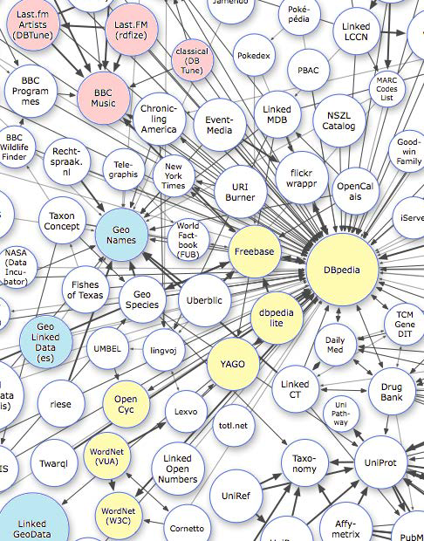
Using ontology
Knowledgebase
Linked Data
RDF data
<Subject, Predicate,
Object> triples
More kinds of
relations

Slide 12
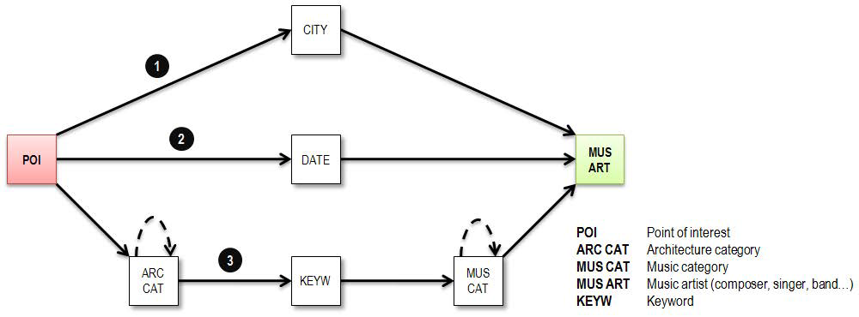
Linking knowledge in different domains
Find paths in the knowledge graph.

Slide 13
Semantic knowledge framework
Let E = C ∪ I be the set of class and instance entities.
We define 2 functions rele and relr
rele：E -> R⁺
relr：E×E -> R⁺
rele represents the relevance value assigned to entities. relr represents the relevance value assigned to relations between pairs of entities.

Slide 14
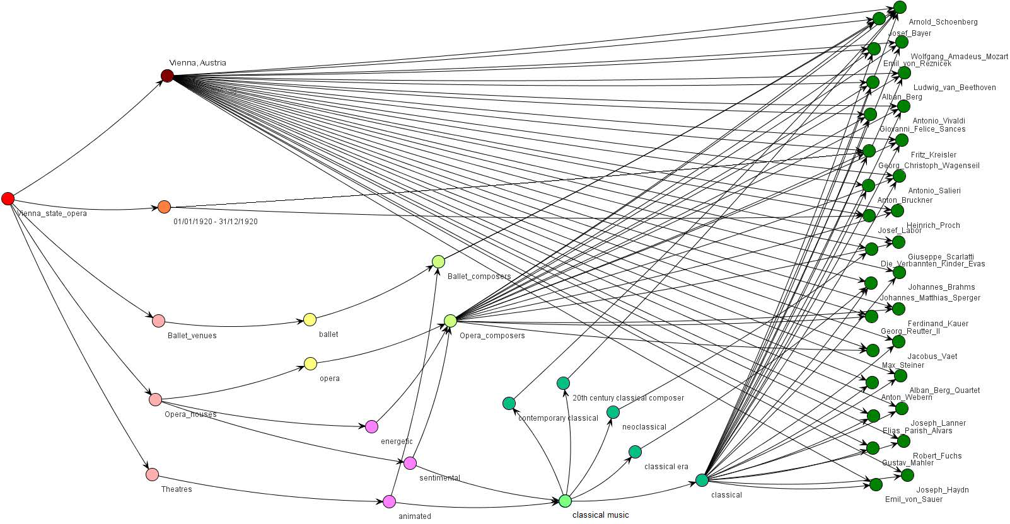
Semantic network

Slide 15
Semantic network
Assigning weights
V：I × I -> R⁺
V(I, I’) = f(relr(I, I’), relr(C, C’))
C, C’ are concepts over I, I’.

Slide 16
Cross-domain Recommendations
Calculated the relevance between the instances by the paths found between them.
Consider the weight of the edges.
Accumulate these relevance in some way.

Slide 17
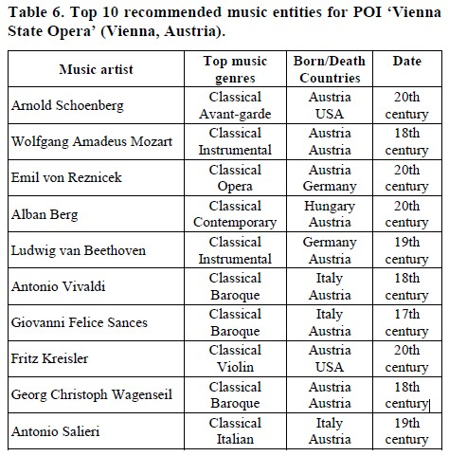
Result

Slide 18
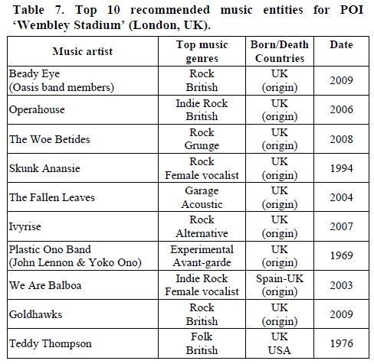
Result

Slide 19
Problems on TV project
Rating sparsity blocks usage of CF
Ontology may be a good approach
No Chinese knowledgebase is available
Trying a corpus-based approach

Slide 20
For your comments
Any questions, discussions and suggestions are welcome.
Thank you.

